Slide 1

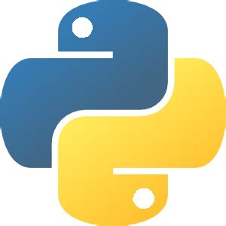


Data Science tools
Excel
Python
SAS
Tableau
Apache Spark
Jupyter
BigML
Matplotlib
Matlab
Tensorflow

